Slide 1
Single-cell transcriptomics
Dr. Matthew L. Settles
Genome Center
University of California, Davis
settles@ucdavis.edu
Sponsored by Lexogen

Slide 2
The sequencing of the transcriptomes of single-cells, or single-cell RNA-sequencing, has now become the dominant technology for the identification of novel cell types and for the study of stochastic gene expression.

Slide 3
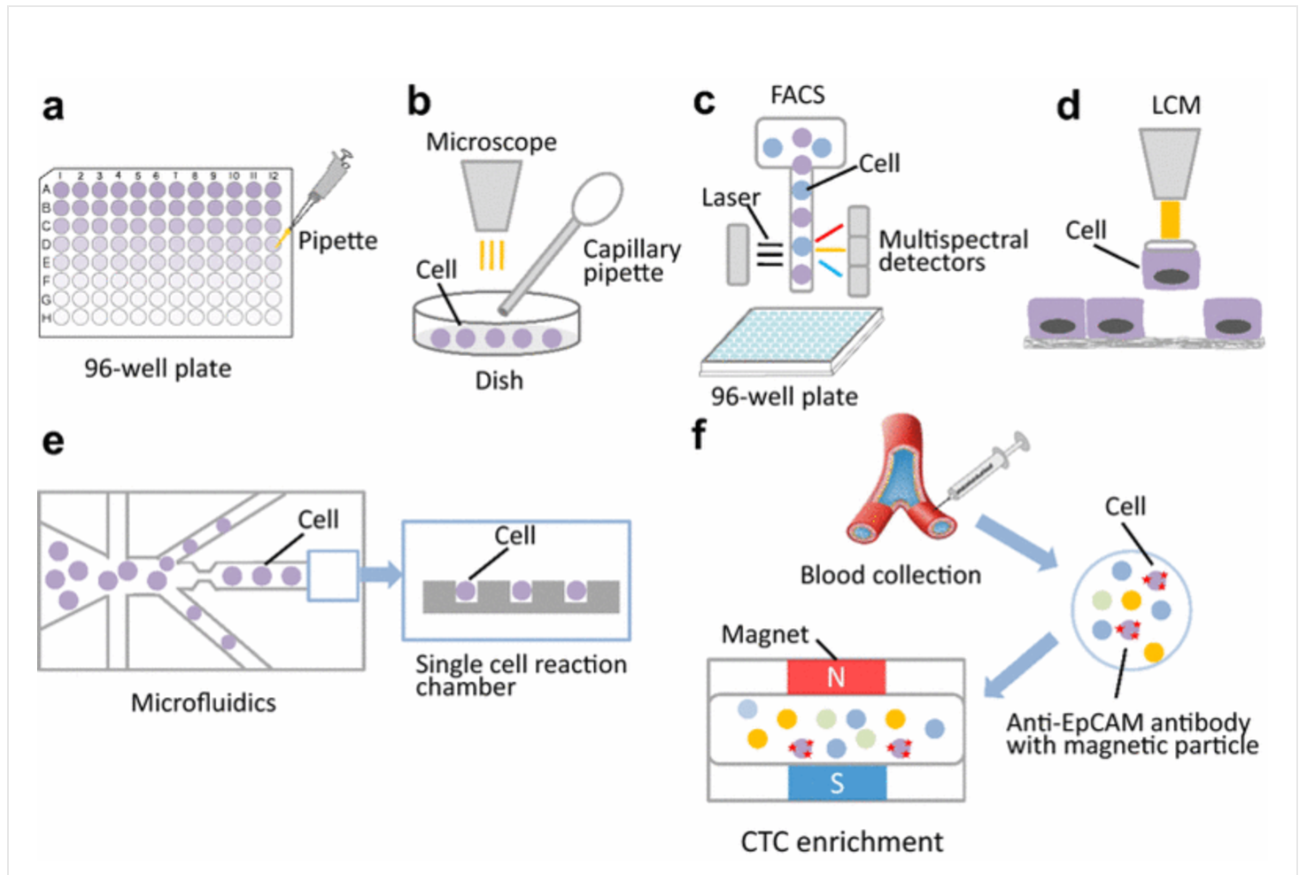
Single-cell isolation methods
Single cell sequencing: a distinct new field
Jian Wang and Yuanlin Song

Slide 4
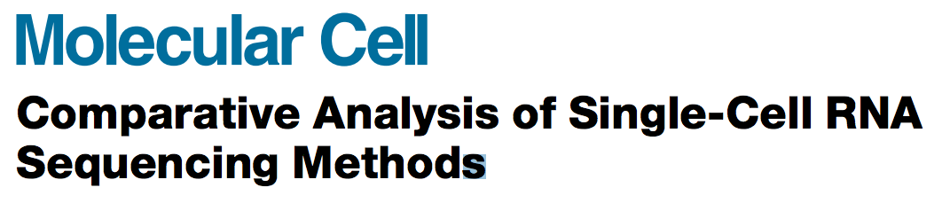
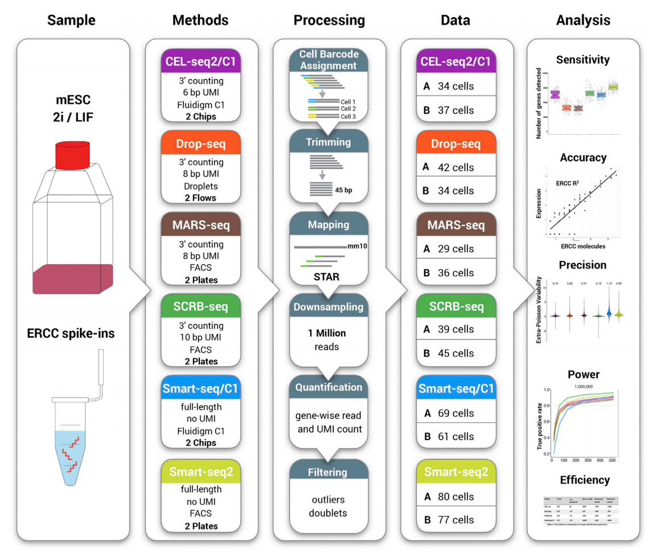
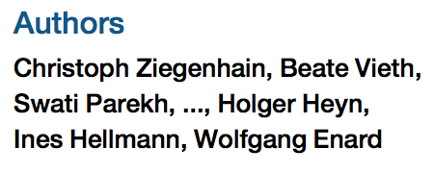

Slide 5
Single-Cell with 10x genomics
Gene expression profiling at scale with single cell resolution

Slide 6
What 10x is currently used to do
Genome –– Genome Resequencing
Call the full spectrum of variants (particularly long INDELS/CNV and structural variants) and unlock previously inaccessible regions from a single library at equivalent coverage as standard genome resequencing projects
Exome – Subselect reads using capture techniques (Agilent)
Enable phasing of genes and detection of structural and copy number variation
Agilent SureSelect baits improve gene phasing by closing gaps, and recovering hard-to-map loci in the genome (future kits to include previously failed regions)
Assembly – de Novo genome assembly
Single Cell 3’ RNAseq
High-throughput single cell RNA sequencing
Scalable transcriptional profiling of 1,000s to 10,000s of individual cells

Slide 7
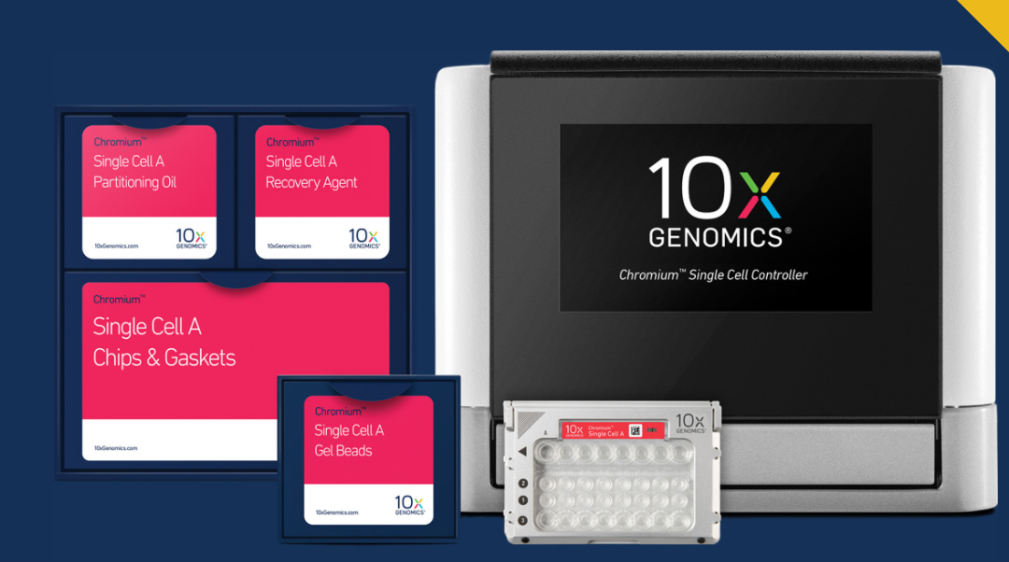
10x Chromium Box

Slide 8
Basic Stats
Up to 8 channels processed in parallel
500 to 6,000 (V1) 10,000 (V2) cells per channel
10 minute run time per chip
Up to 30 um cell diameter tested
~50 % cell processing efficiency
User controlled trade off between cell numbers and doublet rate
Number of cells | Expected Doublet Rate (%)
500 | ~0.4
1,000 | ~0.8
3,000 | ~2.3
5,000 | ~3.9
10,000 | ~7.6
Number of cells | Expected Doublet Rate (%)
1,200 | ~1.2
3,000 | ~2.9
6,000 | ~5.7

Slide 9
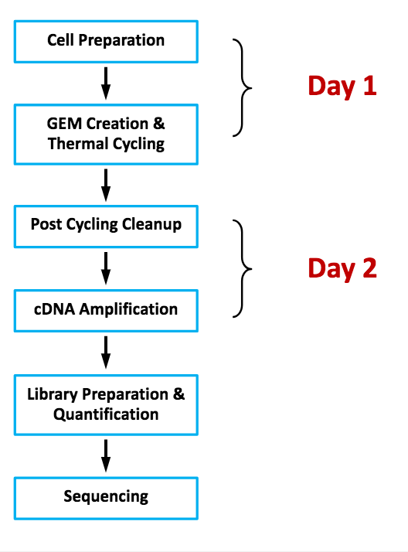
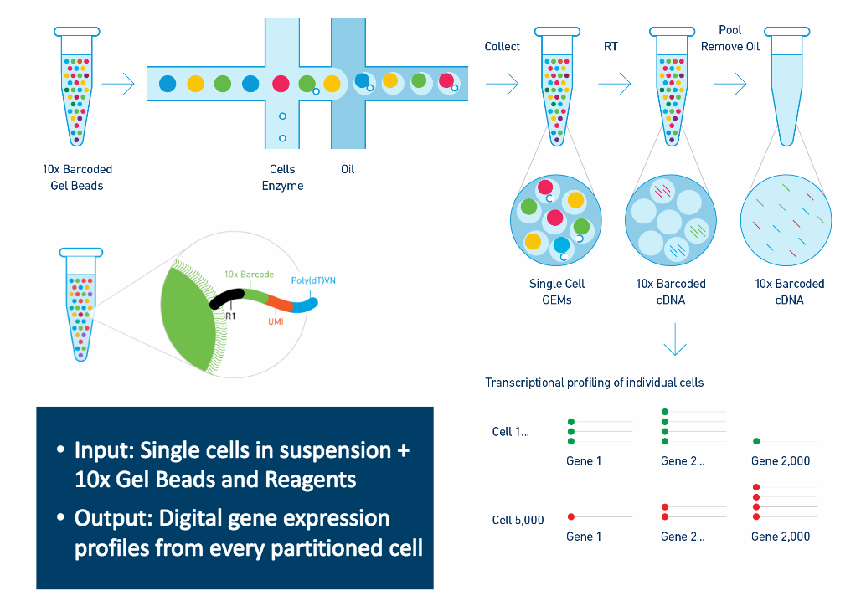

Slide 10
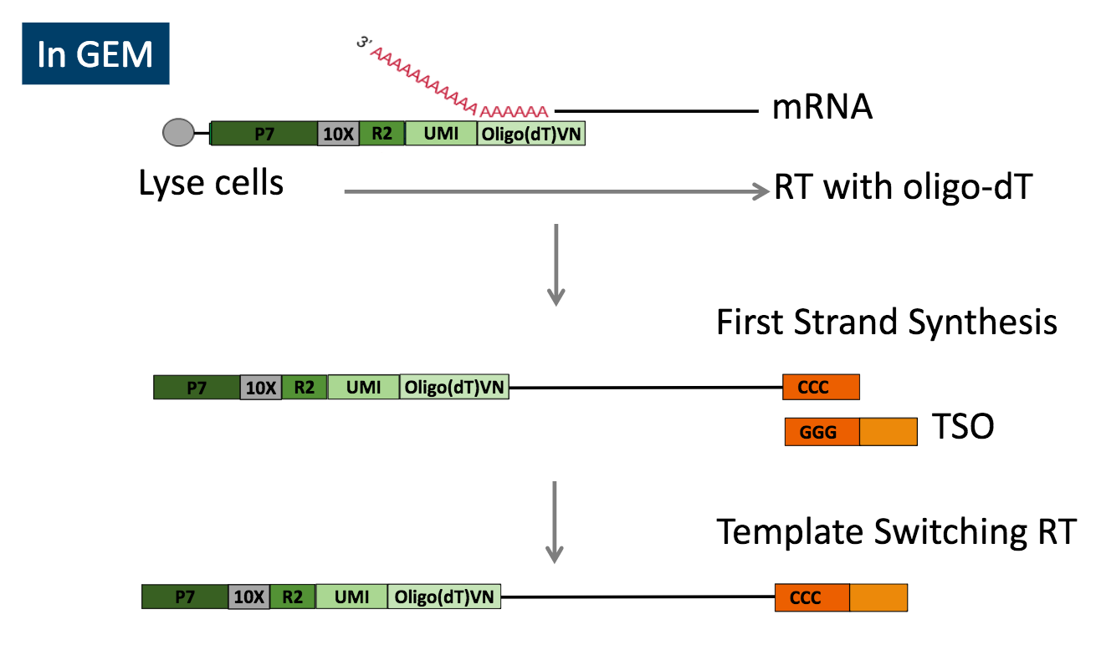
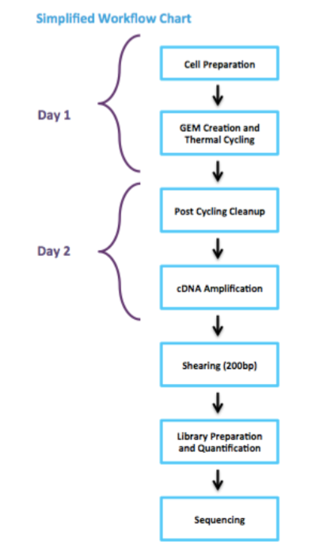
Basically a TAGseq protocol per cell 3’ expression

Slide 11
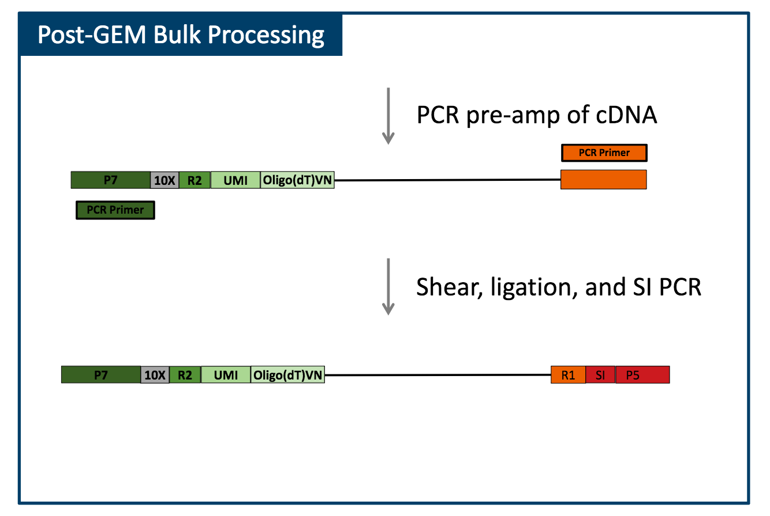

Slide 12
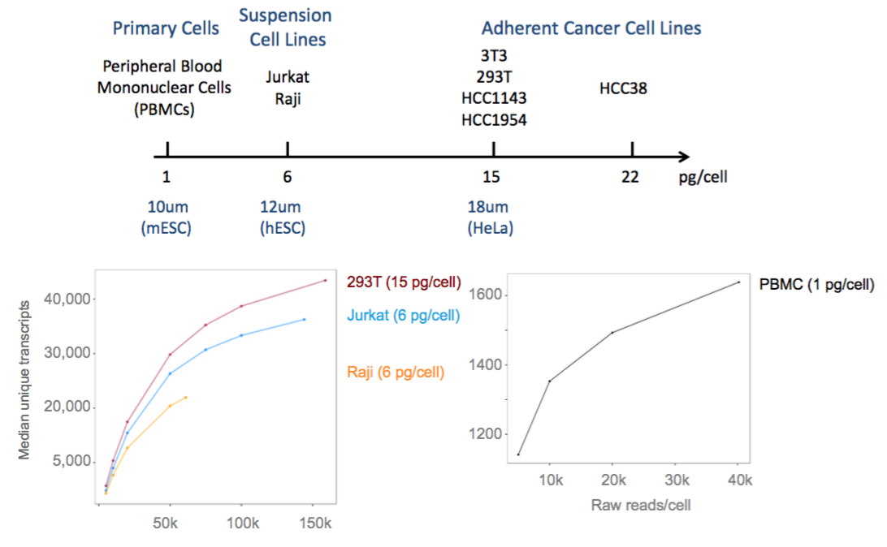
Cells of differing sizes and complexity

Slide 13
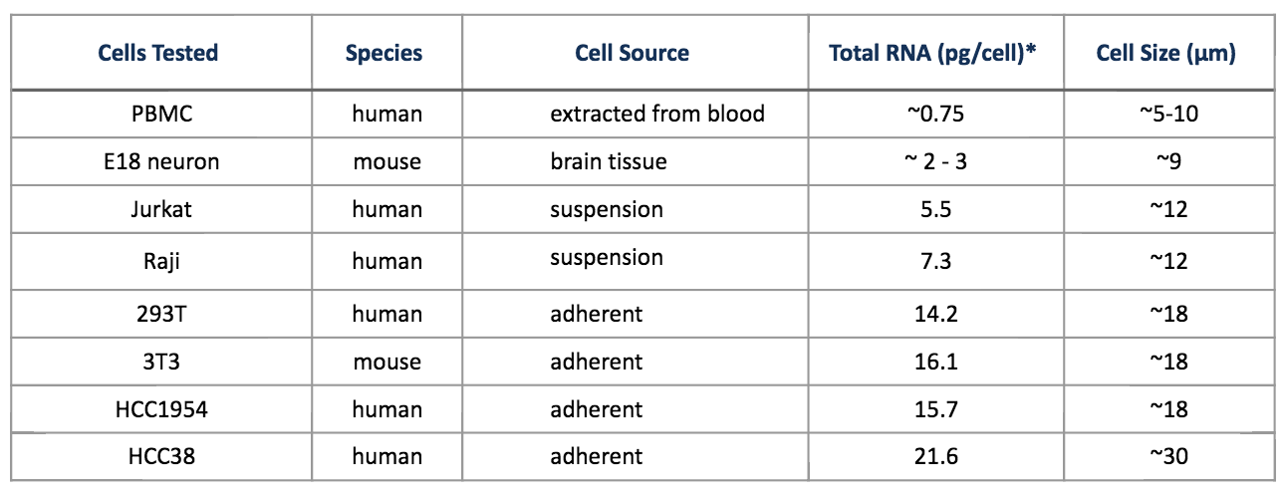
Cell size requirement are minimal

Slide 14
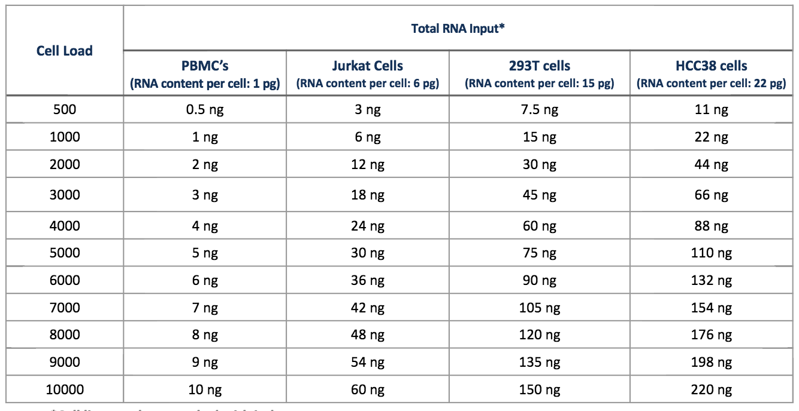
Wide window of RNA input

Slide 15
Sequencing, V1
Recommendation
60,000 raw reads per cell is the recommended sequencing depth for typical samples.
30,000 raw reads per cell is sufficient for RNA-poor cell types such as PBMCs.
Given variability in cell counting/loading, extra sequencing may be required if the cell count is higher than anticipated.
Validated on
HiSeq 2500 Rapid Run
NextSeq
MiSeq
Custom sequencing run, with 4 reads, V1 kits
Sequence Read | Recommended Length | Read Description
Read 1 | 98bp | Transcript Tag
I7 Index | 14bp | Cell Barcode Read
I5 Index | 8bp | Sample Index Read
Read2 | 10bp | UMI Read
@ full capacity 6,000 cells per sample and 60K reads per cell = 360M reads or ~1 lane/sample

Slide 16
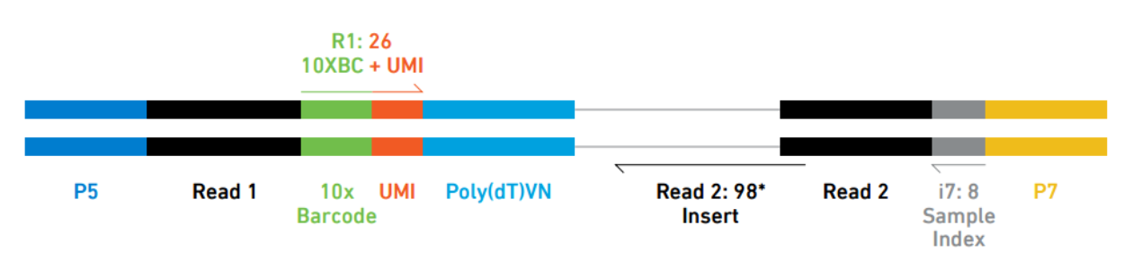
Sequencing, V2
Recommendation
50,000 raw reads per cell is the recommended sequencing depth for typical samples.
30,000 raw reads per cell is sufficient for RNA-poor cell types such as PBMCs.
Given variability in cell counting/loading, extra sequencing may be required if the cell count is higher than anticipated.
Validated on
HiSeq 4000
HiSeq 2500 Rapid Run
NextSeq
MiSeq
Custom sequencing run, with 3 reads, V2 kits
Sequence Read | Recommended Length | Read Description
Read 1 | 100bp | 10 barcode and UMI
I7 Index | 8bp | Sample Index Read
Read2 | 100bp | Transcript Tag
@ full capacity 10,000 cells per sample and 60K reads per cell = 500M reads or ~1.25 lane/sample

Slide 17
Software – System requirements
Local
Run on single, standalone Linux system
CentOS/RedHat 5.2+ or Ubuntu 8.04+
8+ cores, 64GB RAM
Cluster
Run on SGE and LSF
Each node must have 8+ cores and 8GB+ RAM/core
Shared filesystem between nodes (e.g. NFS)
50 core-hours per 100M reads, 5000 cells, 40k reads/cell: 95 core-hours

Slide 18
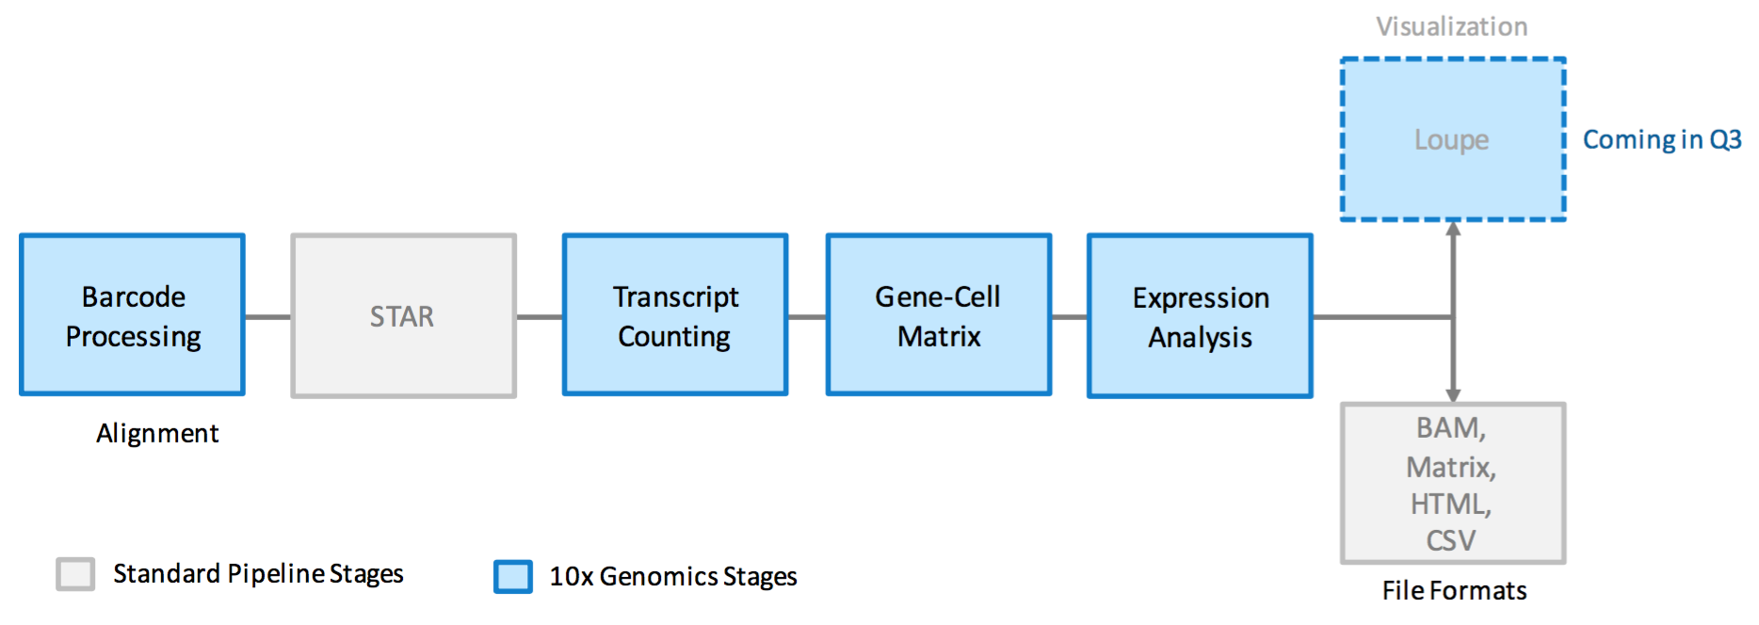
Analysis Workflow
Barcode
UMI
Extraction
Barcode and UMI
filtering
Mark Duplicates
Filer Cells

Slide 19
Cell Barcode and UMI filtering
Cell barcodes
– Must be on static list of known cell barcode sequences
– May be 1 mismatch away from the list if the mismatch occurs at a low- quality position (the barcode is then corrected).
UMIs
– Must not be a homopolymer, e.g. AAAAAAAAAA
– Must not contain N
– Must not contain bases with base quality < 10
– UMIs that are 1 mismatch away from a higher-count UMI are corrected to that UMI if they share a cell barcode and gene.

Slide 20
Marking Duplicates
Using only the confidently mapped reads with valid barcodes and UMIs,
– Correct the UMIs
UMIs are corrected to more abundant UMIs that are one mismatch away in sequence.
– Record which reads are duplicates of the same RNA molecule – Count only the unique UMIs as unique RNA molecules – These UMI counts form an unfiltered gene-barcode matrix.

Slide 21
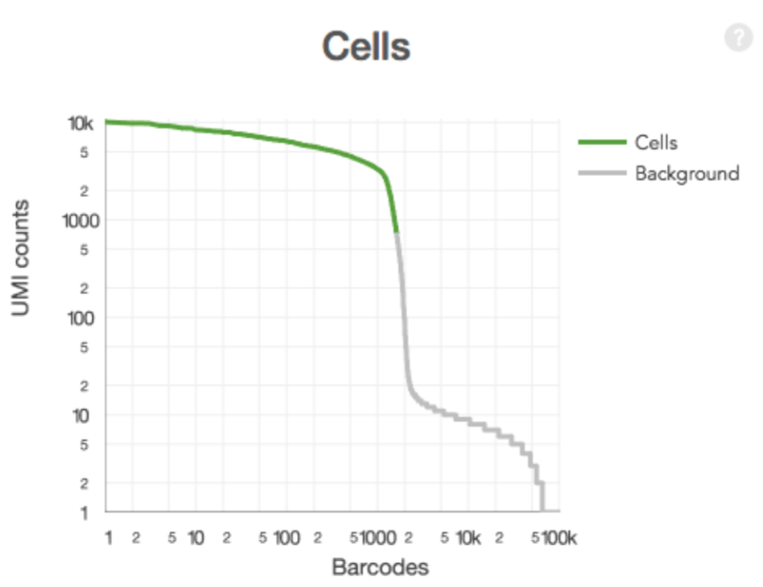
Filtering Cells
Select GEMs that likely contain cells
– Sum UMI counts for each barcode
– Select barcodes with total UMI count >10% of the 99th percentile of the expected recovered cells.
Produces a filtered gene-barcode matrix.

Slide 22
Downstream Analysis – offered by cell ranger
Clustering analysis results
For each ‘K’ (number of clusters desired): – Which cells go into which clusters – Differentially expressed genes across cluster
Principle Component Analysis (PCA) results
How much each gene contributes to the lower-dimensional space
PCA projection coordinates of cells
t-SNE analysis results
The coordinates of each cell in 2-d space
R packages
10x genomics
Seurat https://github.com/satijalab/seurat

Slide 23
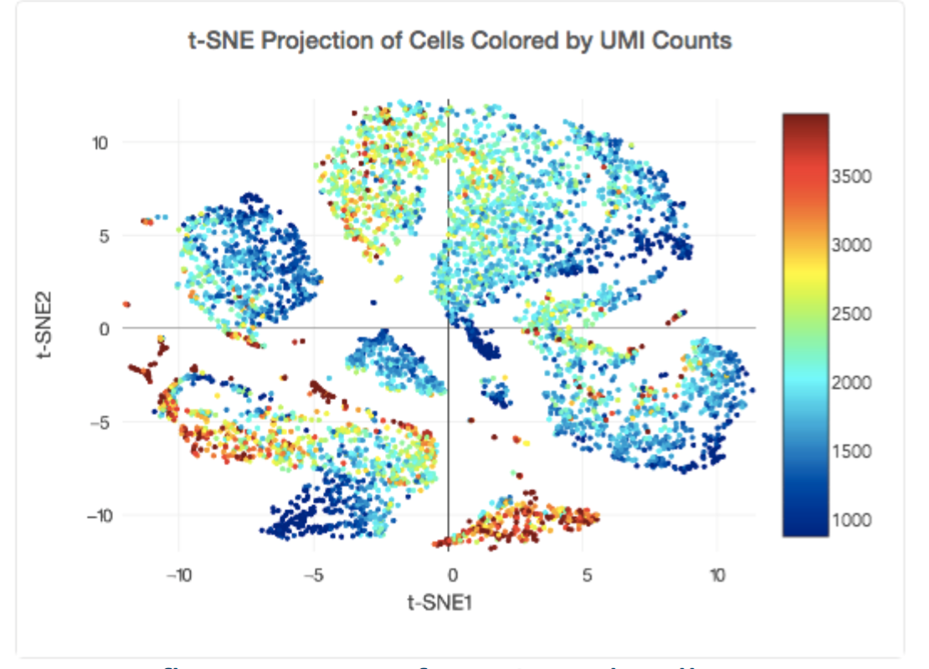
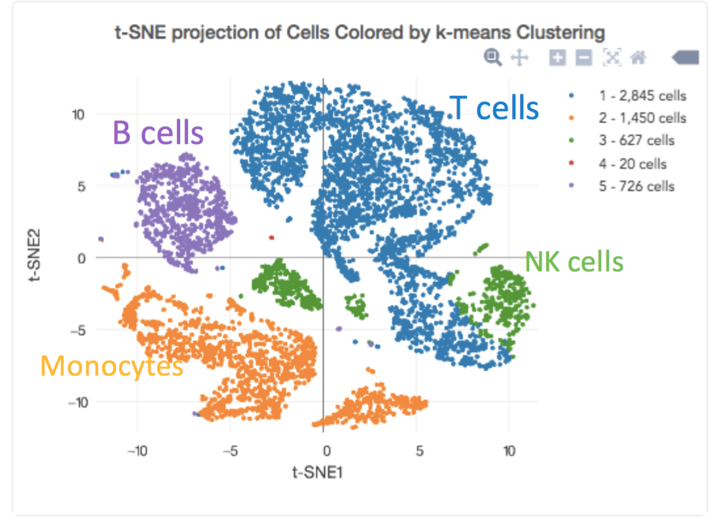
The classical clustering plot

Slide 25
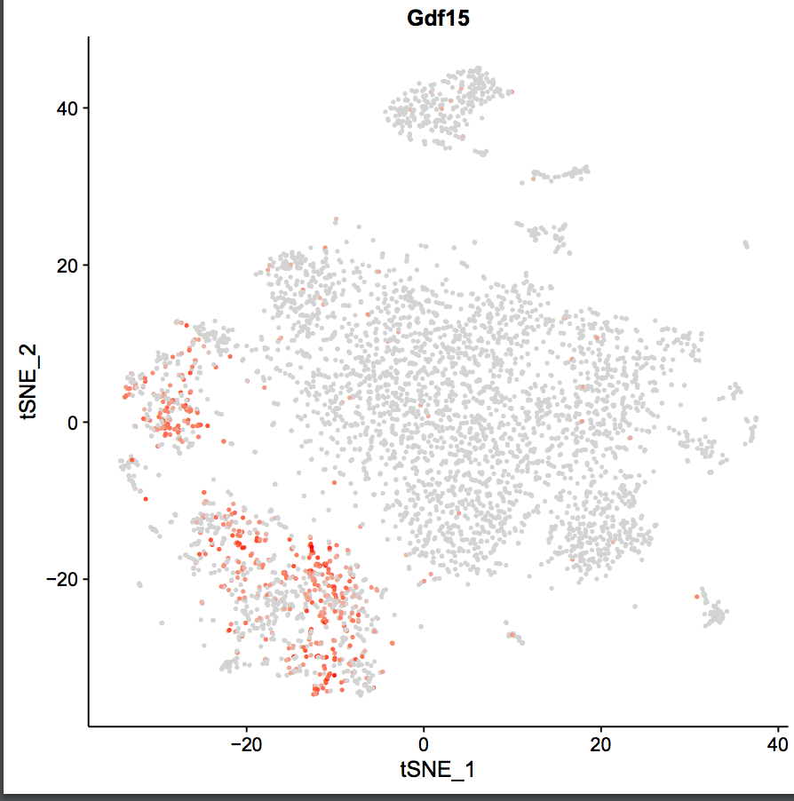

Slide 26
Genome and Exome Analysis
Long-range analysis and phasing of SNVs, indels, and structure variants

Slide 27
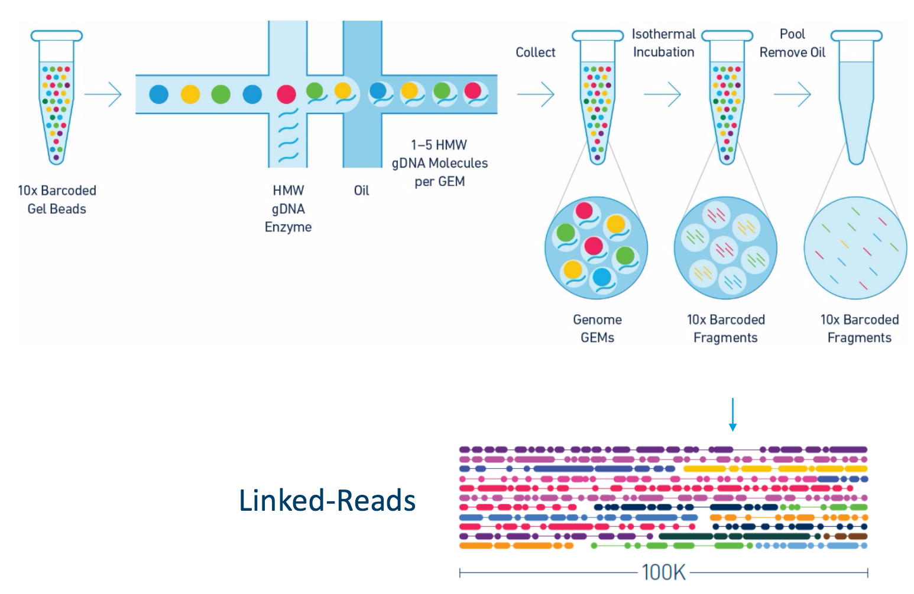
In a nut shell

Slide 28
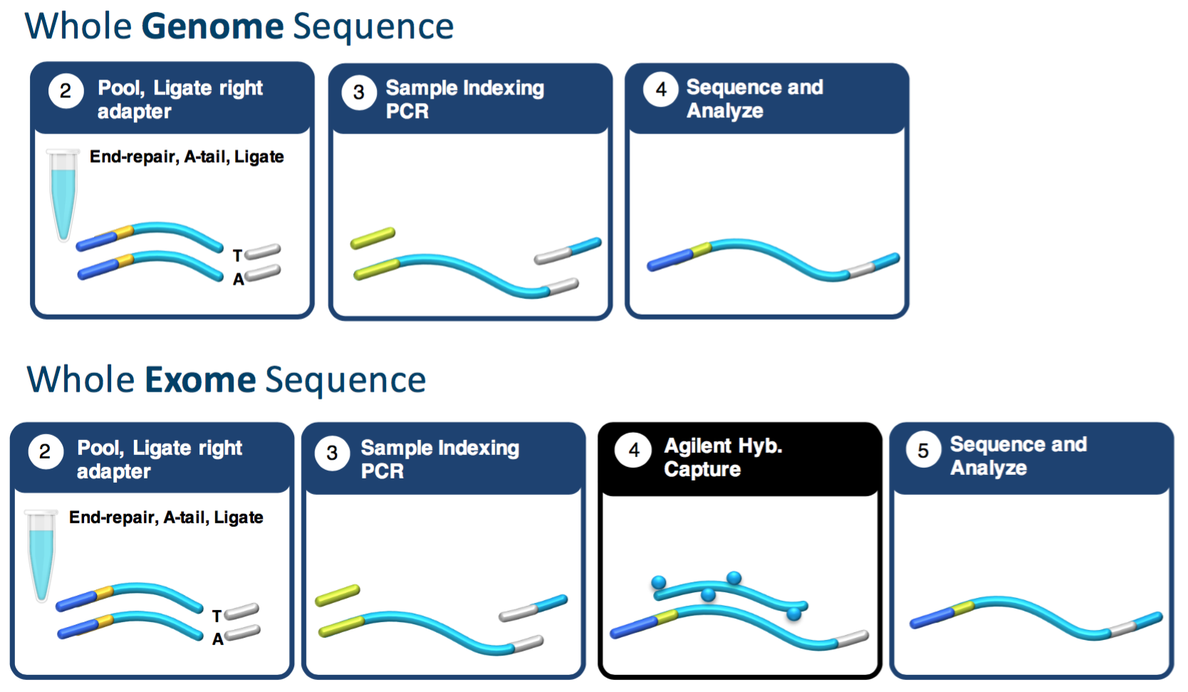
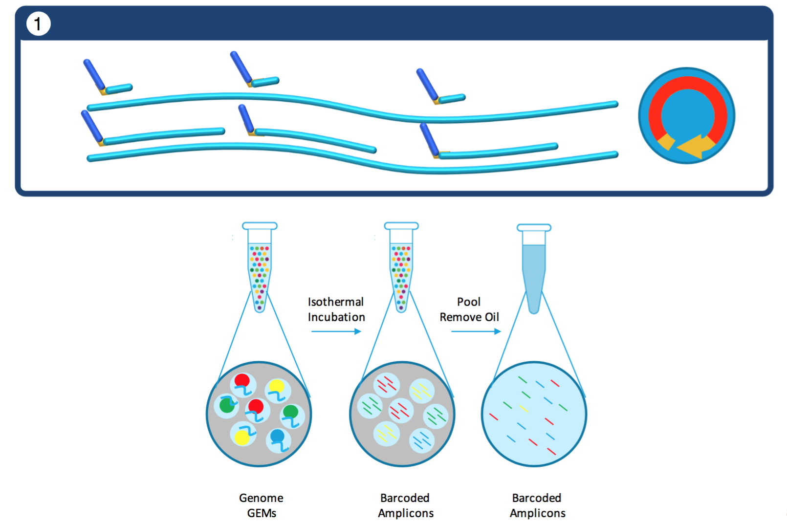
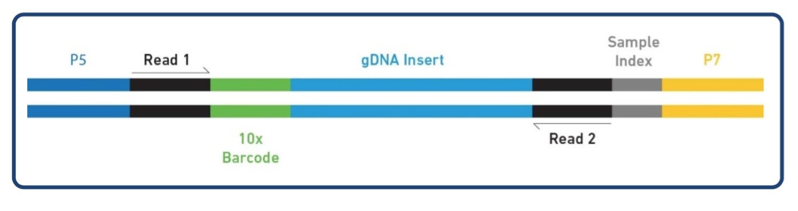
Laboratory Workflow
Shear?

Slide 29
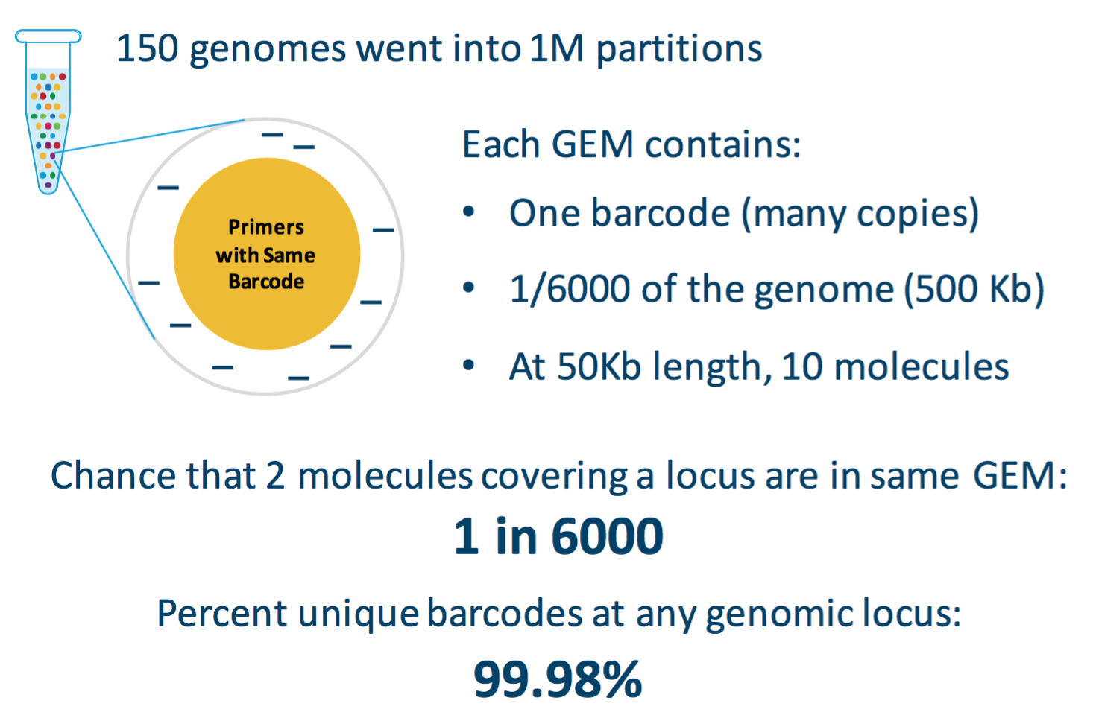
The Math
1 ng Input DNA = 300 genomes copies of the genome
Calculations imply that about 50% of all possible fragments end up in a bead

Slide 30
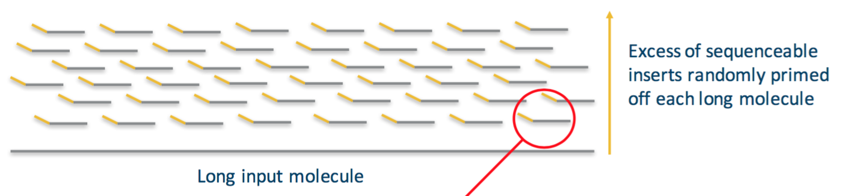
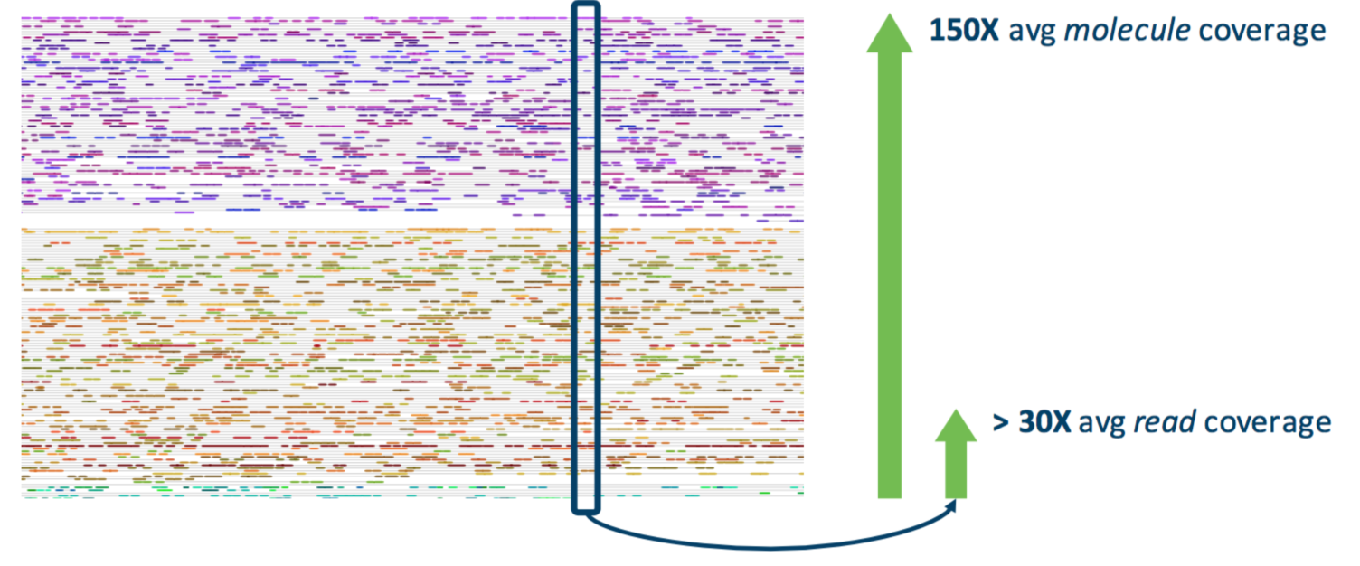
@ Recommended Loading
Each locus will have 150 molecules
Each locus will have 30x read depth
~35 fragments per molecule
@50Kb molecules = 0.2x/molecule

Slide 31
Analysis – Biological Questions
At recommended specs (for human genome)
Get ~30x coverage, adequate for standard variant analysis SNPs, small INDELS
Increased mapability to difficult regions [multi-mapped reads can be resolved by considering linked reads information], variants previously undetermined
Detect large SV and CNV
Phased information
Detection of SV and CNV requires advanced computational techniques
Phasing has been used extensively in GWAS (usually imputed) to enhance analysis and inferences, slow to get to sequence based data
Potential applications for the technology are likely still yet to come

Slide 32
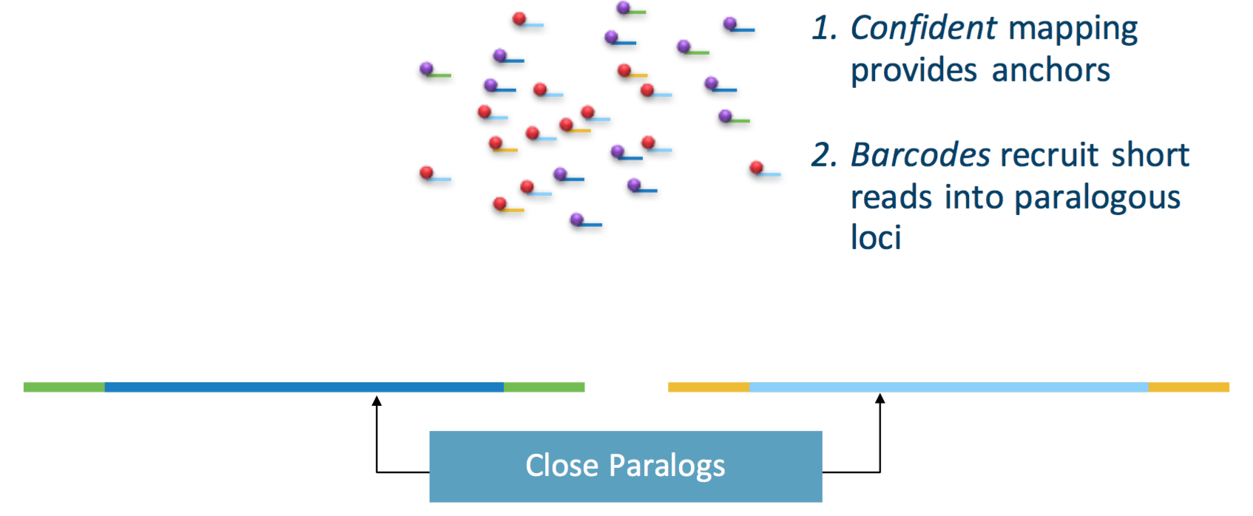
Increased Mapability

Slide 33
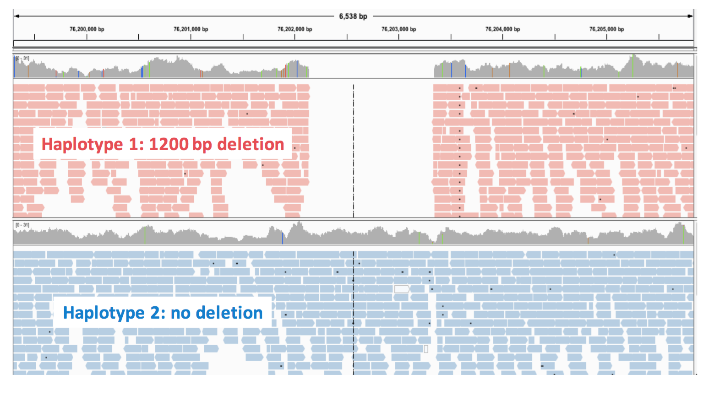
Linked Reads

Slide 34
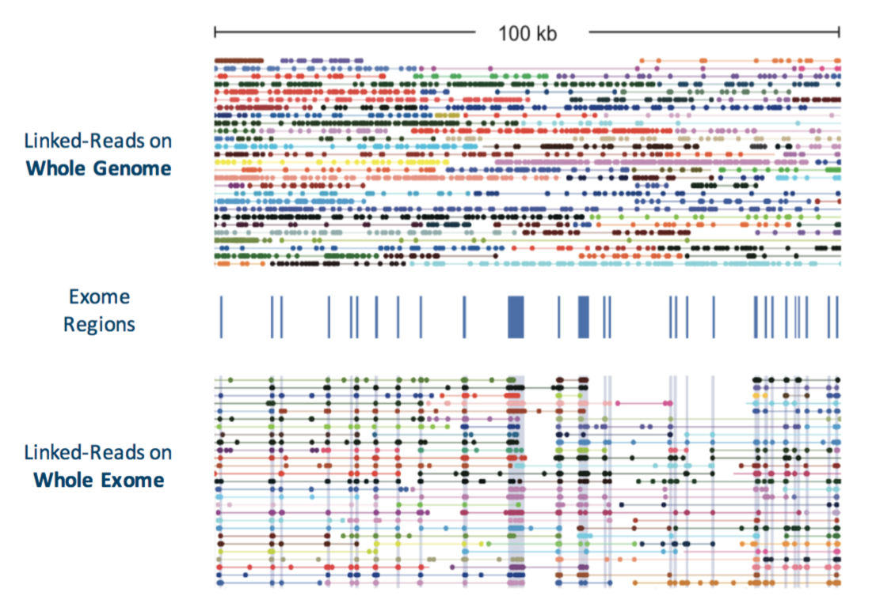
Capture – linked genes
Enrich reads of interest instead of random selection
Depending on size of capture, can pool more samples/lane

Slide 35
Assembly
de novo assemblies

Slide 36
Sample Requirements - Supernova
Genome size: Supernova has been tested on genomes in the size range 1.0-3.2 Gb.
Other genome characteristics: Supernova has not been tested on genomes having repeat content far greater than human, nor on genomes having extreme GC content.
Clonality: strongly recommend that DNA be obtained from an individual organism or clonal population.
DNA size: Recommend that this value be at least 50 kb, and preferably 100 kb. DNA length is highly correlated with several assembly statistics, including contig length, phase block length and scaffold length.

Slide 37
Sequencing - Supernova
Instrument | Configuration | Result | Lanes
HiSeq X | Standard | Excellent | 2
HiSeq 2500 | Rapid run | Excellent | 4
HiSeq 2500 | High Output | Not tested
HiSeq 4000 | Standard | Useable, but observed contig length half as long as those from HiSeq X | 2
Miseq | standard | Not tested
Read length: Supernova requires as input 2x150 base reads.
Sequencing depth: Recommends sequencing to depth between 38x and 56x. For highly polymorphic organisms, we recommend 56x. Coverage higher than 56x may not improve results. Sequence twice as much as mapping application

Slide 38
System Requirements - Supernova
16-core (or greater) Intel or AMD processor
384 GB RAM
2 TB free disk space
64-bit CentOS/RedHat 5.2+ or Ubuntu 8+
Bcl2fastq 2.17
No other large processes running on the system **
Supernova should be run with at most 1.2 billion reads (single reads),
and at 38-56x coverage of the genome.

Slide 40
Genome Stats
Genome | Size (Gb) | DNA size(Kb) | N50 contig(Kb) | N50 scaffold(Mb) | N50 phase block (Mb)
NA12878 | 3.2 | 95.5 | 85.0 | 12.8 | 2.8
NA24385 | 3.2 | 111.3 | 90.0 | 10.4 | 3.9
HGP | 3.2 | 138.8 | 104.9 | 19.4 | 4.6
Yoruban | 3.2 | 126.9 | 100.5 | 16.1 | 11.4
Komodo dragon | 1.8 | 85.4 | 95.3 | 10.2 | 0.4
Spotted owl | 1.5 | 72.2 | 118.3 | 10.1 | 0.2
Hummingbird | 1.0 | 86.2 | 87.6 | 12.5 | 10.1
Monk seal | 2.6 | 92.3 | 93.8 | 14.8 | 0.6
Chili pepper | 3.5 | 53.3 | 84.7 | 4.0 | 2.1

Slide 41
Genome Quality - Pac Bio vs 10x
Qualitatively
Pac Bio will produce >> N50 contig lengths (contiguous sequence) on the order of 10 – 50x larger contig N50
10x will will produce >> N50 scaffold length (ordered and arranged contigs with gaps) on the order of 2-5x larger scaffold N50
Costs
Human Genome sequenced at ~60x coverage
(recommended depth for both Pac Bio and 10x)
$70,000 Pac bio
$8,500 (4 lanes, HiSeq 2500 2x150, rapid mode) [~$5000 on the X platform]
Input DNA
10x requires ~ 1ng input DNA relative to ~10ug of input DNA for Pac Bio

Slide 42
In Conclusion
As with many of these newest technologies, sample/cell preparation is crucial to success
Expect to purchase more equipment related to sample/cell preparation
Expect some time spent on optimization, especially with single cell RNA
As with every new technology there are still detail and kinks to be worked, ex. HiSeq 4000 is inevitable
Ahead of its time for phased analysis/experiments (Diplomics)
Expect other applications, methodologies to grow out of the technology, as people play new “seqs” will arise

